Slide 1
SADHANA 1 - Performance Overview

Slide 2
Performance Summary
Auto-generated dashboard
Generated by Dashboard Engine v1.2 | 2026-03-20

Slide 3
reg_vs_part_schl_wise - Overall
Registered: 469
Generated by Dashboard Engine v1.2 | 2026-03-20

Slide 4
reg_vs_part_schl_wise - APS GOLCONDA
Registered: 183
Generated by Dashboard Engine v1.2 | 2026-03-20

Slide 5
reg_vs_part_schl_wise - APS R K PURAM Secunderabad
Registered: 286
Generated by Dashboard Engine v1.2 | 2026-03-20

Slide 6
reg_vs_part_grade_wise
Generated by Dashboard Engine v1.2 | 2026-03-20

Slide 7
all_subjects_perf_summary
Generated by Dashboard Engine v1.2 | 2026-03-20

Slide 8
grade_4_sub_wise_avg_perf
Generated by Dashboard Engine v1.2 | 2026-03-20

Slide 9
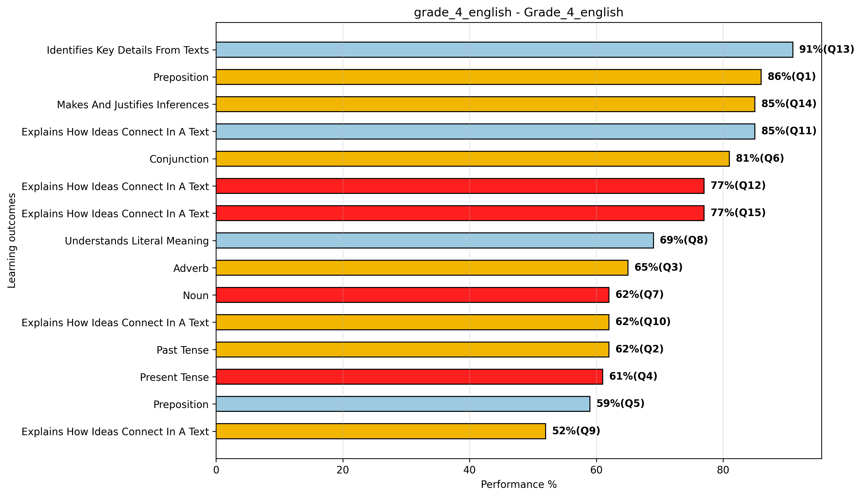
grade_4_english_lo_question
Generated by Dashboard Engine v1.2 | 2026-03-20

Slide 10
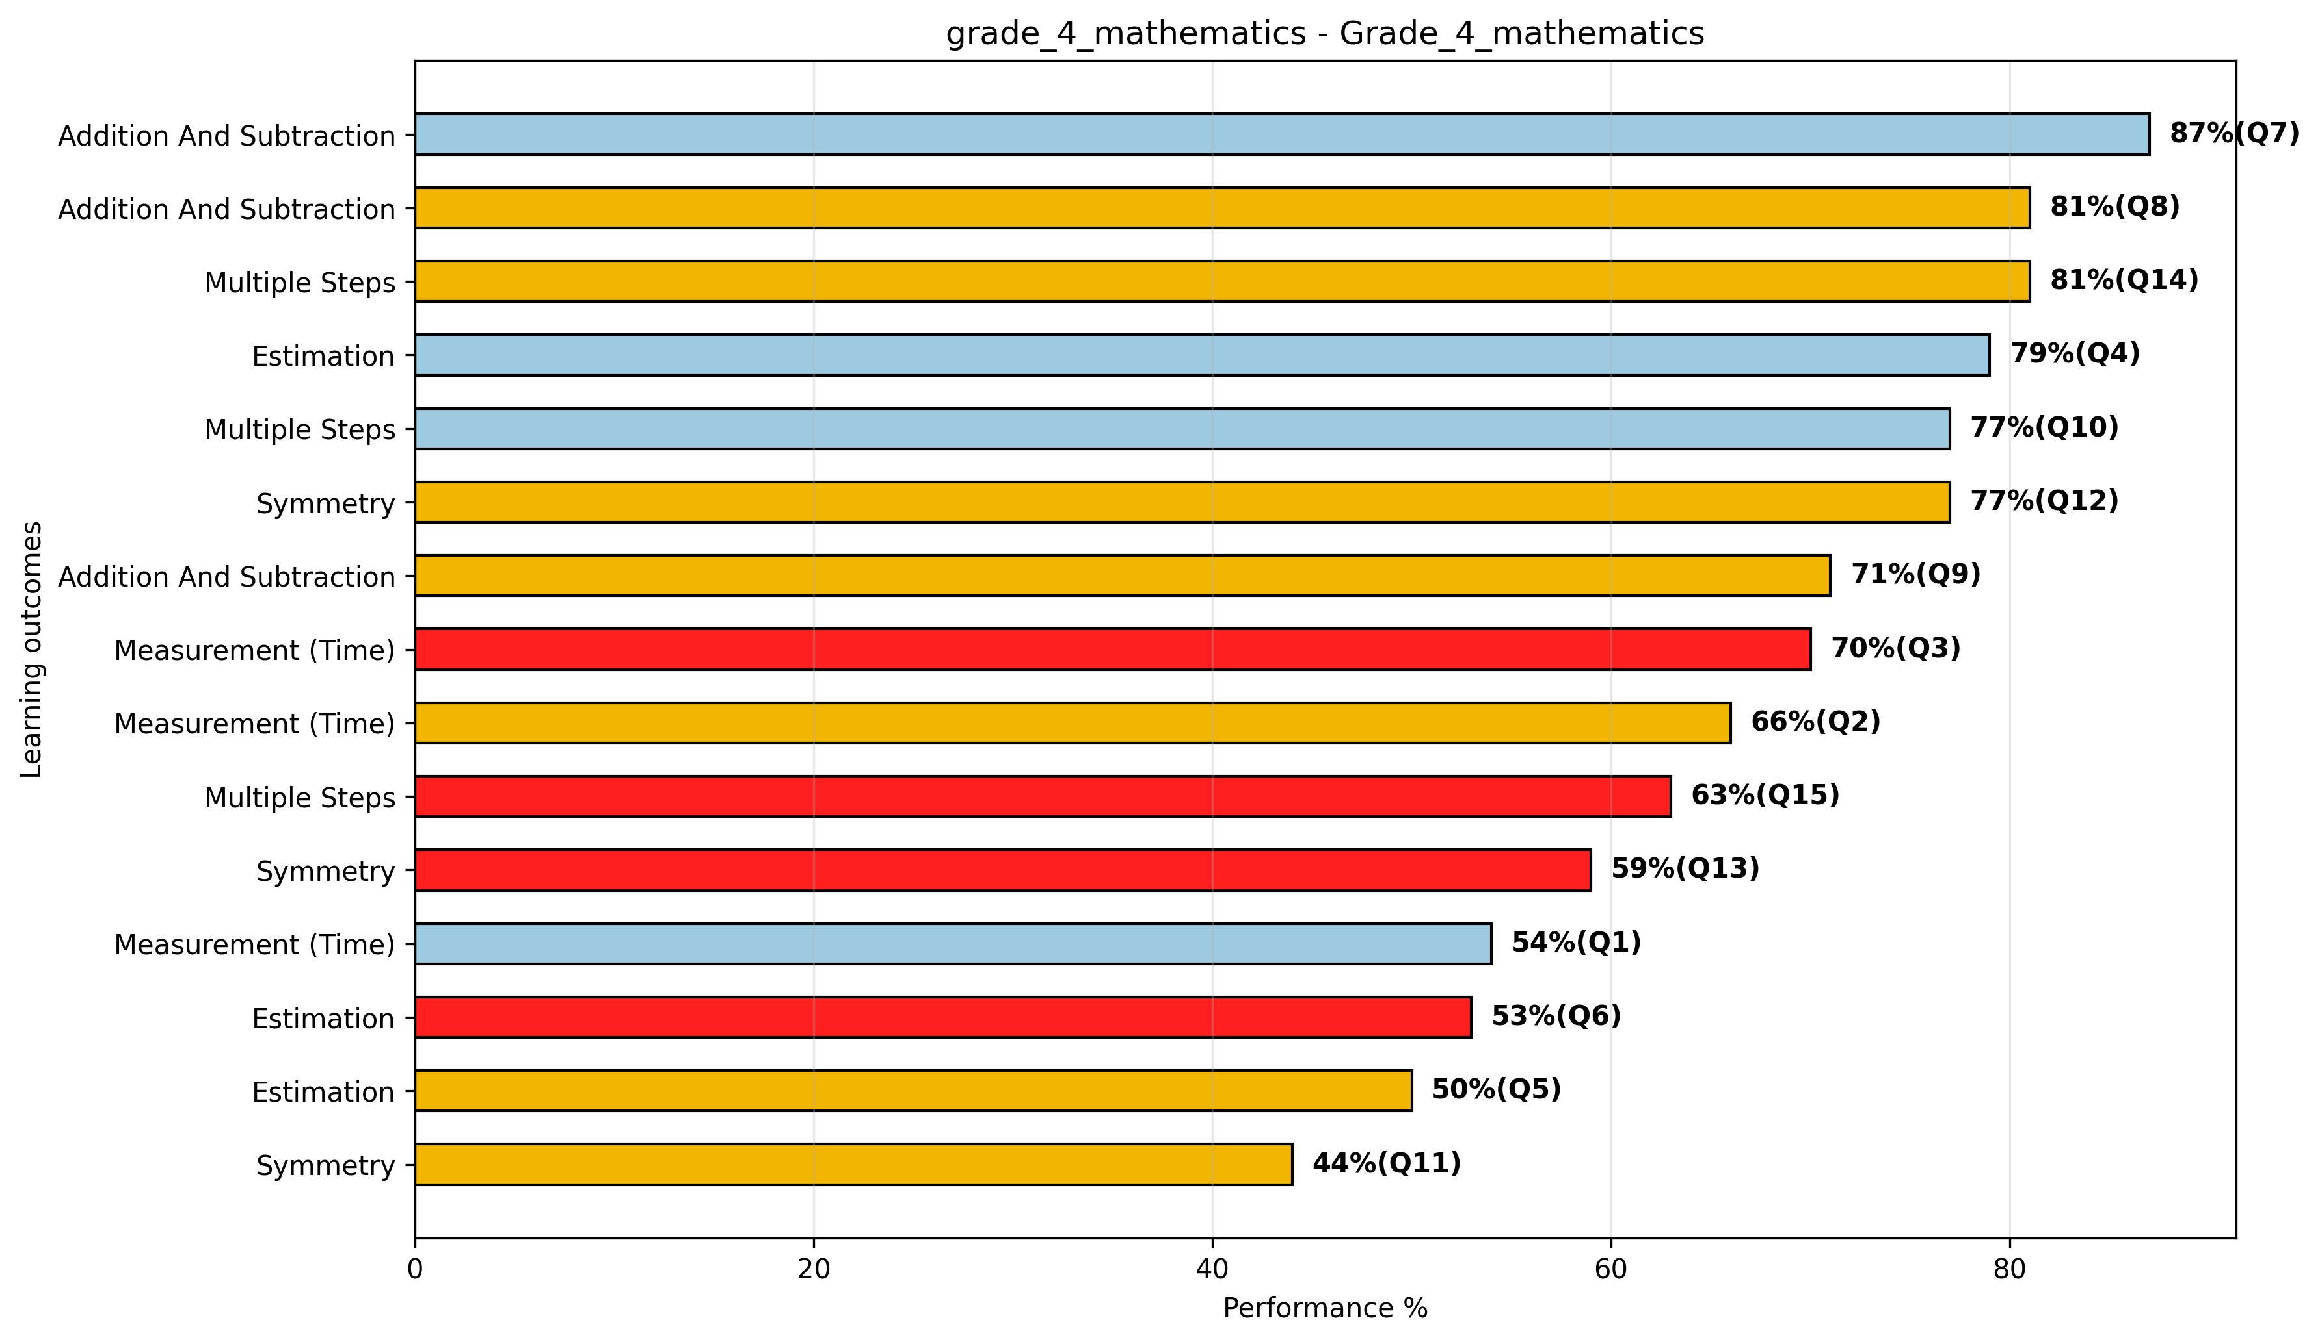
grade_4_mathematics_lo_question
Generated by Dashboard Engine v1.2 | 2026-03-20

Slide 11
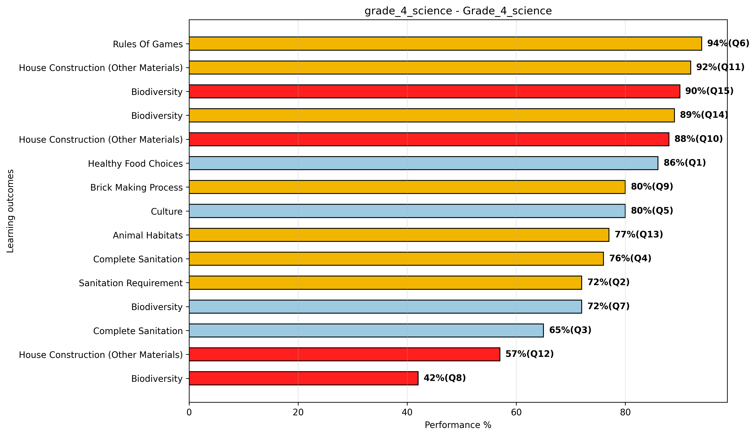
grade_4_science_lo_question
Generated by Dashboard Engine v1.2 | 2026-03-20

Slide 12
grade_4_english_qlvl
Generated by Dashboard Engine v1.2 | 2026-03-20

Slide 13
grade_4_mathematics_qlvl
Generated by Dashboard Engine v1.2 | 2026-03-20

Slide 14
grade_4_science_qlvl
Generated by Dashboard Engine v1.2 | 2026-03-20

